Slide 1
A Cohort Comparison Tool for Exploratory Data Analysis
Dr. Lydia Briggs
NHS-R Conference
Data Scientist
Digital Research Environment (DRE) at Great Ormond Street Hospital (GOSH)
2020

Slide 2
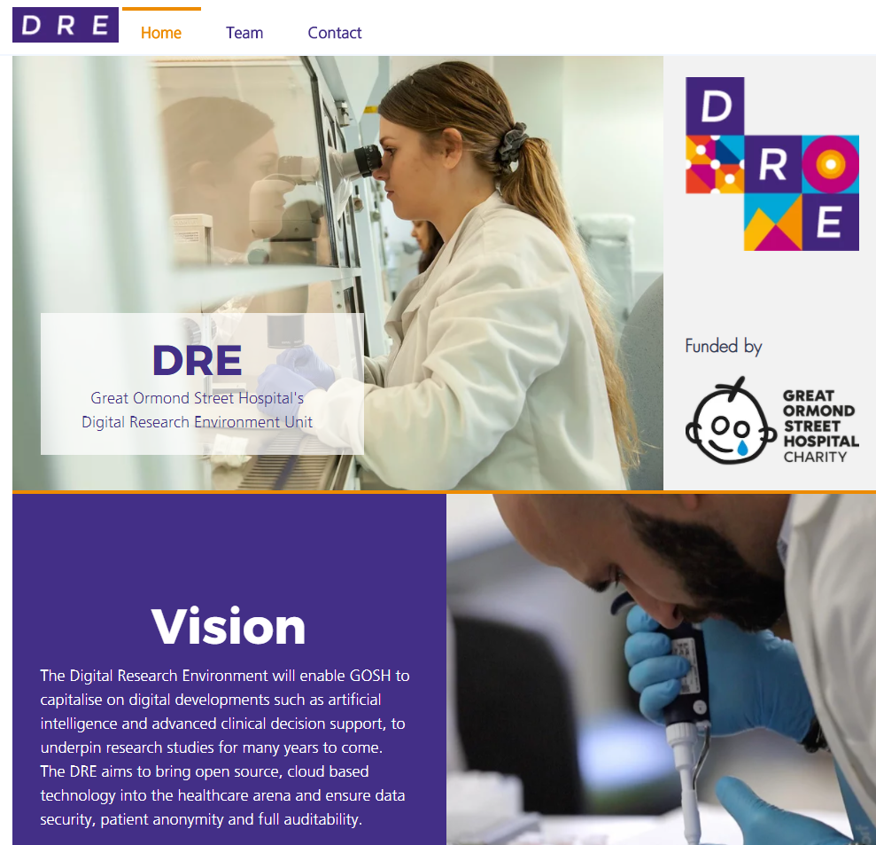
The Digital Research Environment (DRE) at GOSH
Provides clinicians with the analytical tools to make accessing and harnessing the power of health data as easy as possible.
Data extraction
Pipeline to extract clinical data.
Provide much more data than was previously available.
Support external and internal data analytics and data science.

Slide 3
A Cohort Comparison Tool for Exploratory Data Analysis
A lot of information is presented to researchers in healthcare data.
Patient demographics, vital signs, diagnoses
Laboratory results
Ward data
Admissions data
Difficult to identify trends between clinically relevant groups.
Useful to visualise data to account for differences between different time events.
A tool is required that inputs all the data and shows standard visualisations in an easy to read report format.

Slide 4
A Cohort Comparison Tool for Exploratory Data Analysis
A lot of information is presented to researchers in healthcare data.
Patient demographics, vital signs, diagnoses
Laboratory results
Ward data
Admissions data
Difficult to identify trends between clinically relevant groups.
Useful to visualise data to account for differences between different time events.
A tool is required that inputs all the data and shows standard visualisations in an easy to read report format.
COCATOO
A Cohort Comparison Tool for Exploratory Data Analysis

Slide 5
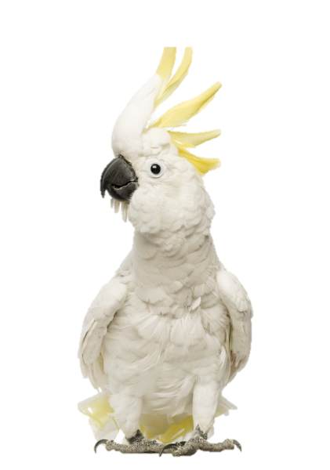
COCATOO Development
Data Extraction
The DRE have established core datasets of research relevant clinical …… data.
Structured
Core information
De-identified
Presented as research data views (RDV) on our research platform.
Examples of RDVs
Data Extraction
R Functions/ Packages
Specification File
Generalised Analytics
Hospital Admissions | Patient Demographics
Ward Stays | Patient Vital Signs
Patient Laboratory Results | Patient Diagnoses
User Report

Slide 6

COCATOO Development
R Functions and Packages
Data Extraction
project_specification.R
Project rules to define cohort/ control groups
functions.R
Generalised R functions
Visualisations
Themes
R Functions/ Packages
Specification File
global.R
Installs/ loads R packages
Imports all RDVs
Wrangles data for relevant information
Generalised Analytics
User Report

Slide 7
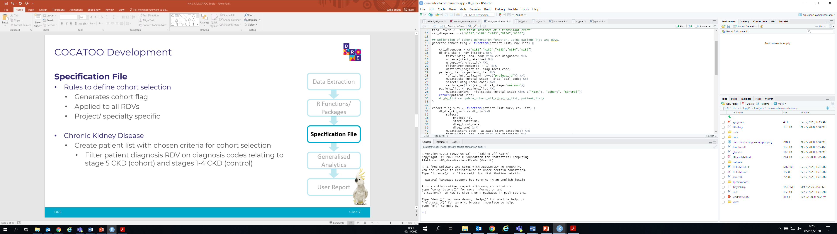
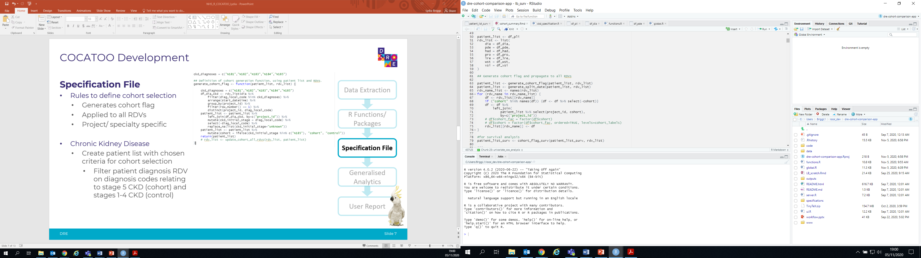
COCATOO Development
Specification File
Rules to define cohort selection
Generates cohort flag
Applied to all RDVs
Chronic Kidney Disease
Filter patient diagnosis RDV on diagnosis codes
Stage 5 CKD (cohort)
Stages 1-4 CKD (control)
Data Extraction
R Functions/ Packages
Specification File
Generalised Analytics
User Report

Slide 8
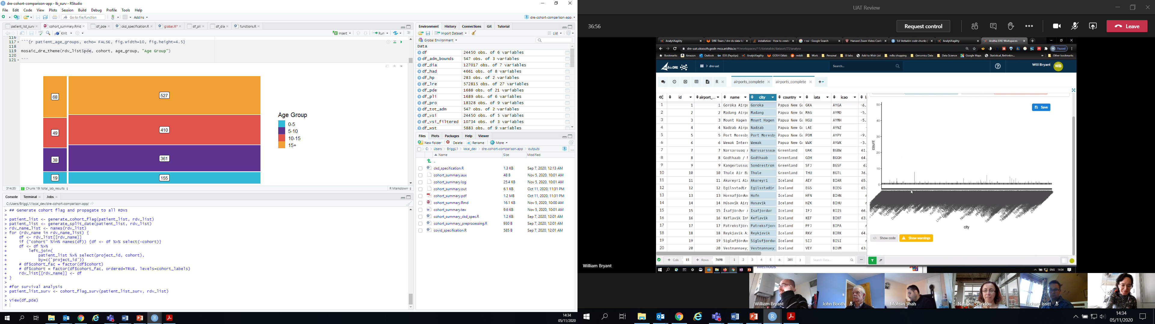
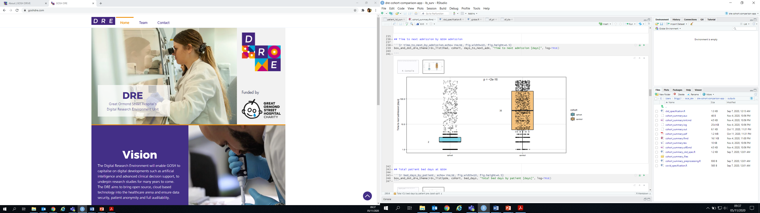
COCATOO Development
Generalised Analytics
Enable cross specialty adaptability as a result of the standard RDVs the DRE offers.
In addition to plot and theme formats from global.R and functions.R files.
Easily modified project_specification.R file to change chosen cohort/ control population split.
Data Extraction
R Functions/ Packages
Specification File
Generalised Analytics
User Report

Slide 9
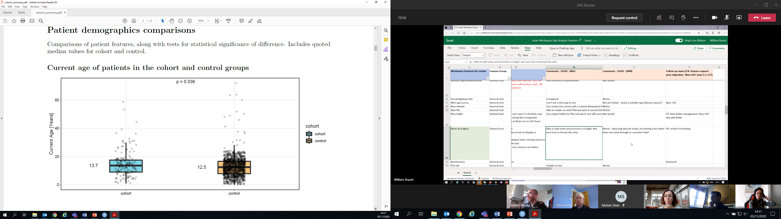
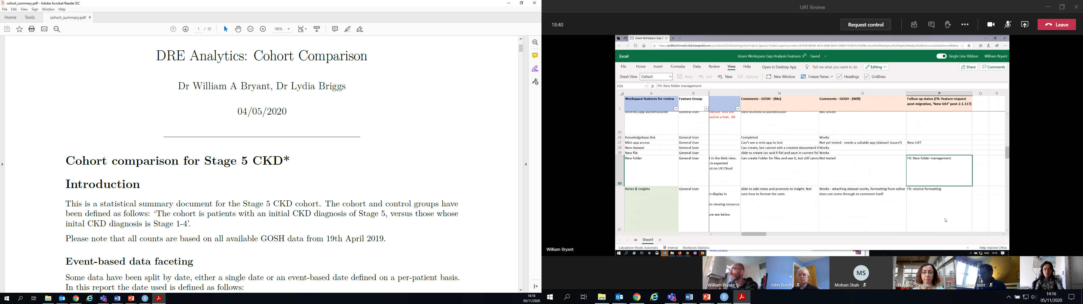
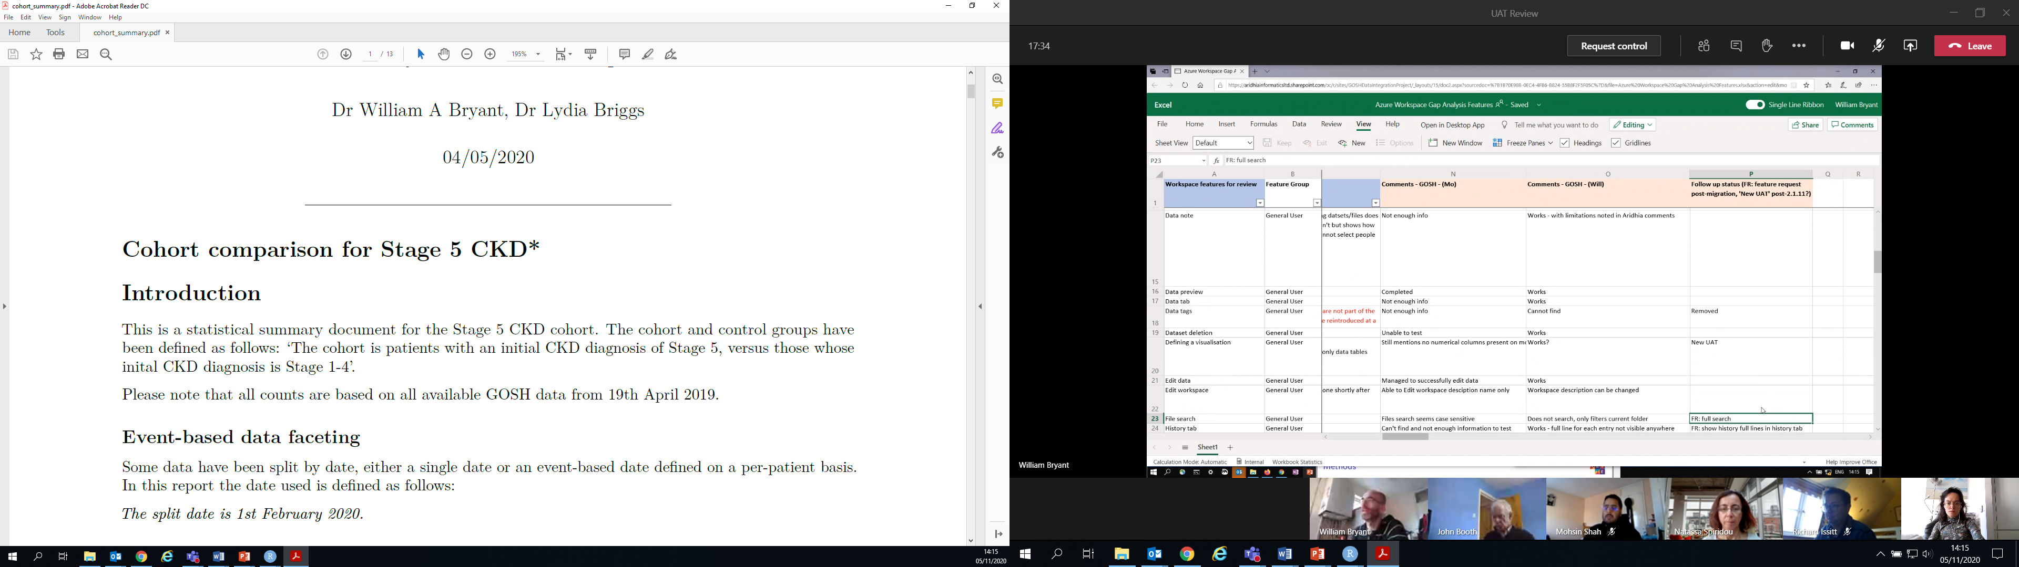
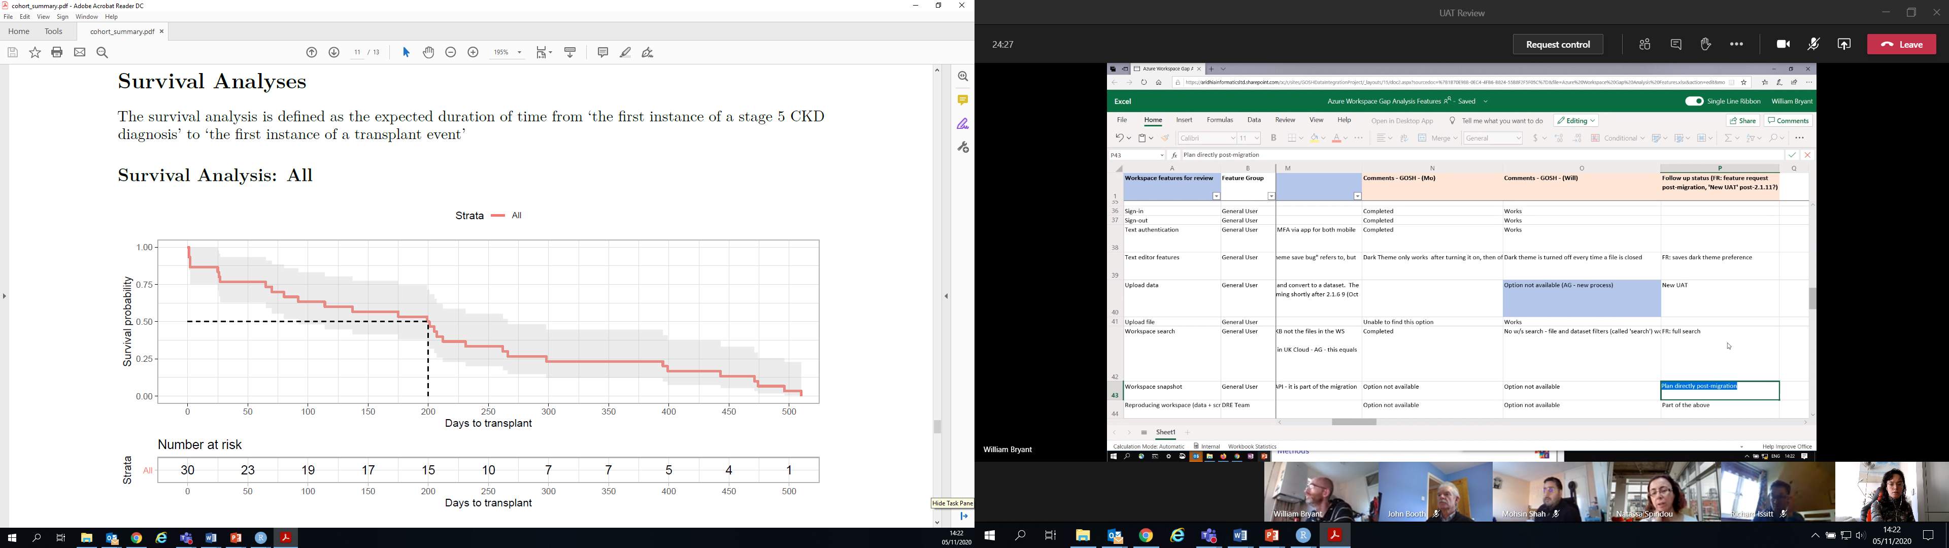
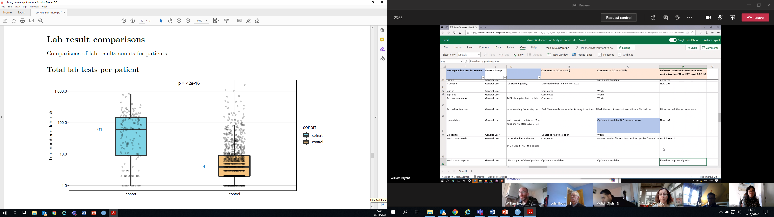
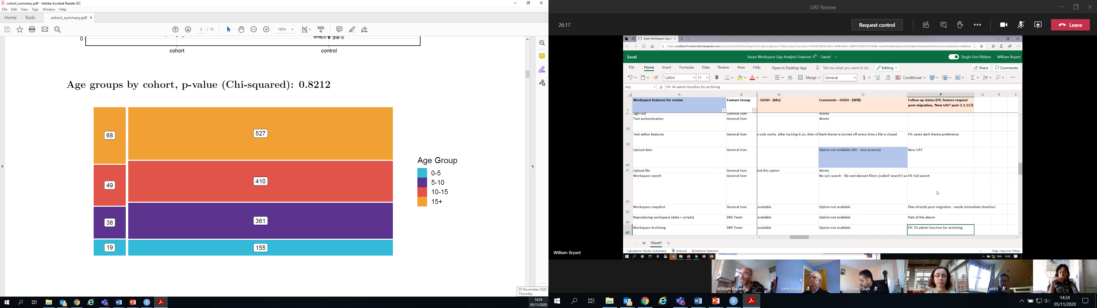
COCATOO Development
Report
Data Extraction
R Functions/ Packages
Specification File
Generalised Analytics
User Report

Slide 10
Summary and Future Goals
Summary
COCATOO is a cohort comparison tool which utilises the DREs data extraction pipeline and generalised R code to present clinical information to the researcher.
Has the ability to be used by researchers in any GOSH clinical speciality with the modification of the specification file with project rules.

Slide 11
Summary and Future Goals
Summary
COCATOO is a cohort comparison tool which utilises the DREs data extraction pipeline and generalised R code to present clinical information to the researcher.
Has the ability to be used by researchers in any GOSH clinical speciality with the modification of the specification file with project rules.
Future Goals
Development of an app (R Shiny).

Slide 12
Summary and Future Goals
Summary
COCATOO is a cohort comparison tool which utilises the DREs data extraction pipeline and generalised R code to present clinical information to the researcher.
Has the ability to be used by researchers in any GOSH clinical speciality with the modification of the specification file with project rules.
Future Goals
Development of an app (R Shiny).
Acknowledgements
DRE Team
Dr. William Bryant, John Booth, Mohsin Shah, Dr. Anastassia Spiridou, Dr. Richard Issitt, Prof. Neil Sebire

Slide 13
POWERED BY ANALYTIXAGILITY

